Slide 1
Problem Statement Title: Conversational Fashion Outfit Generator powered by GenAI.
Team Name: Code of Duty

Slide 2

Team members details
Team Name | Code of Duty
Institute Name/Names | Lakshmi Narain College of Technology & Science (LNCTS), Bhopal
Team Members > | 1 (Leader) | 2 | 3
Name | Shivang Bhatnagar | Abhijeet Nema | Sahil Saxena
Batch

Slide 3
Deliverables/Expectations for Level 2 (Idea + Code Submission)
Idea Documentation:
Outline of image-based approach for personalized fashion outfit recommendations.
Explanation of outfit description-to-image process and ML model for image matching.
Code Implementation:
Develop image generator for outfit images from descriptions.
Integrate ML model for visually similar image identification.
User can give feedback to their generated outfit for further better results.
Expected Impact:
Improved user experience with personalized, visually appealing outfit recommendations.
Gen AI-powered fashion outfit generator for Flipkart that revolutionizes the way users discover and create personalized fashion outfits, in a natural conversational way.

Slide 4
Glossary
Describe/ Expand abbreviations if you have used any in the slides below
ML : Machine Learning
AI : Artificial Intelligence
GEN AI : Generative Artificial Intelligence

Slide 5
Instructions (You Can Delete this Slide)
Dear Team,
Congratulations on reaching this stage - We look forward to some amazing & innovative solutions.
Please find some important instructions before you begin to prepare your submission decks.
Slide Limit : 10 Slides of Content post (after) this Slide
Saving Format : Save the file as a PDF to ensure your formatting remains intact
Submission Guide: Only the ‘Team Leader’ will be able to submit the Deck.
Only the latest submission will be considered as final
(You can keep updating your deck within the deadline)
Wishing you all the very best !
Team Flipkart GRiD

Slide 6
Use-cases
P0: Personalized Outfit Creation: Users can input prompts describing their preferences, occasions, styles, or moods. The system generates unique outfits based on these prompts, allowing users to explore a wide range of personalized options.
P1: Fashion Inspiration and Suggestions: Users seeking inspiration for an outfit can input keywords or themes. The system generates outfits that align with those themes, helping users discover creative and trendy ideas and search in conversational way to give feedback.
P2: Fashion Conversational Model: GEN AI, acting as a conversational model, interacts with the user. Users can give feedback about the generated outfit and expect to have an updated one.

Slide 7
Solution statement/ Proposed approach
Overall Solution: Our solution begins with users sharing fashion preferences via conversational prompts. AI transforms these into images matching tastes. An image classification model analyzes images, extracting key features.
This step of image classification serves a strategic purpose. It aligns the AI-generated outfit with the actual products in our inventory. Smart algorithms compare the generated image's features with those in the dataset to find similar matches. This way, your solution connects user input with a personalized set of images that match their style.
In a continuous pursuit of enhancing user engagement, we've seamlessly integrated a user feedback system. If a generated outfit doesn't perfectly resonate, users can effortlessly provide feedback. This initiates a dynamic conversation, refining the initial prompt with their unique preferences.

Slide 8
Solution statement/ Proposed approach
Sub Problem 1. User Interaction and Personalization Prompt
Solution: Designed a conversational interface where users can input personalized prompts describing their preferences, occasion, and style.
Sub Problem 2. AI Image Generation for Outfits
Solution: Developed a Generative AI model that converts user prompts and generates relevant outfit images, ensuring generated images align with user expectations.

Slide 9
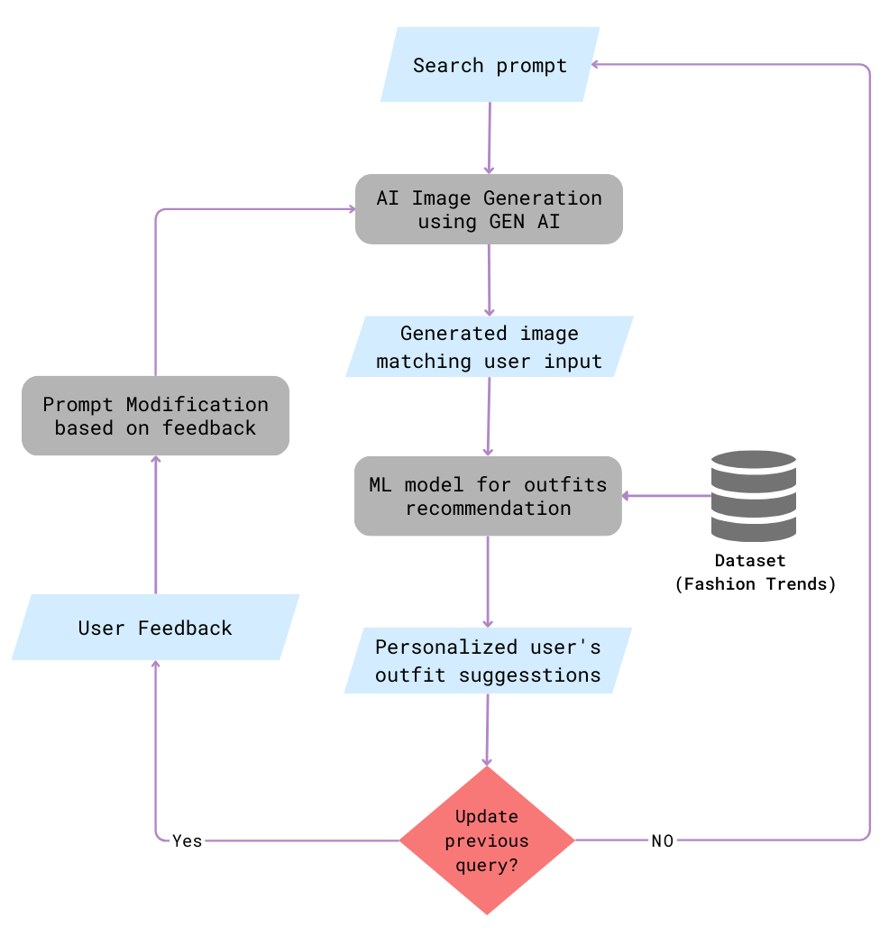
Sub Problem 3. Similar Image Matching with Machine Learning
Solution: Implement an image similarity algorithm, such as feature extraction, to find images similar to the generated one, from dataset containing a wide variety of fashion or product images.
Sub Problem 4. Feedback Loop
Solution: Incorporating a user feedback loop, if an outfit falls short, users can provide input for refinement. This guides AI to deliver even closer-to-heart suggestions.
Fig. Block Diagram

Slide 10
List the limitations of this design/ solution that is being proposed here
Limitations
Limited Dataset Coverage or Regional Variability : The generated outfits might not cover all possible clothing items, styles, or occasions due to dataset limitations. Outfit recommendations might not consider regional fashion preferences or cultural differences.
Limited User Prompts Understanding: The system might struggle to accurately understand complex or ambiguous user prompts. Users may not fully comprehend the inner workings of the Gen AI-powered fashion outfit generator. Users might be uncertain about what type of input the system expects to provide accurate recommendations.
Inaccurate Similar Image Matching: The machine learning model for image similarity might not always identify the most relevant similar images.

Slide 11
Mention the future scope and upcoming details here
Future Scope
Chatbot-Assisted Outfit Exploration:
Idea: Implement a chatbot interface that interacts with users to understand their outfit preferences and needs.
Implementation: Utilize a language model (like ChatGPT) to facilitate a natural conversation with users, eliciting detailed prompts about their desired outfit styles, occasions, and preferences.
2. Seasonal Trend Insights:
Idea: Offer users insights into upcoming seasonal fashion trends.
Implementation: Analyze historical fashion data and trends to predict upcoming seasonal styles. Provide users with trend forecasts and incorporate these trends into recommendations.

Slide 12
3. Virtual Fitting Room:
Idea: Integrate augmented reality (AR) to allow users to virtually try on recommended outfits.
Implementation: Partner with AR technology providers to develop an AR fitting room feature. Users can see how the outfit looks on them through their device's camera.

Slide 13
Thank You

